Slide 1
Managing Continuous Delivery
Jason Whittington
Equifax Workforce Solutions

Slide 2
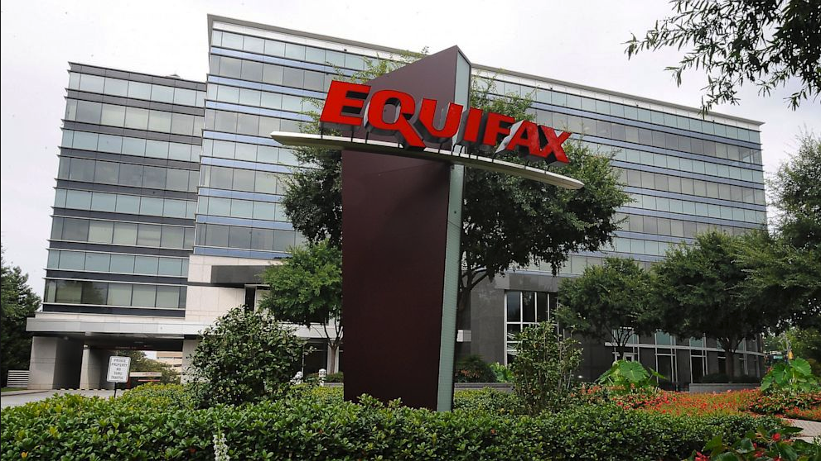
About Equifax
Powering the World with knowledge™
$3.44 billion in revenue
10,200 employees
Headquartered in Atlanta, GA
A global information solutions company
Named to Top 100 American Banker FinTech Forward list (2015-2016)
Named a Top Technology Provider on the FinTech 100 list (2004-2016)
Named an InformationWeek Elite 100 Winner (2014-2015)
Named a Top Workplace by Atlanta Journal Constitution (2013-2017)
Named one of Fortune’s World’s Most Admired Companies (2011-2015)
Named one of Forbes’ World’s 100 Most Innovative Companies (2015-2017)

Slide 3





Equifax Workforce Solutions
Business unit of Equifax Inc.
Rapidly diversifying products and services
Rapid increase in Partner Integrations

Slide 4

Our Team Mission
Our mission: Deliver value faster
Code Changes
New Products
Rapid Feedback

Slide 5

Computing at Equifax
Notes:
Many environments (dev, test, prod)
Many networks (and lots of firewalls)
Global presence (Multiple Data Centers)
Heterogeneous
Not everything is cloud…yet ☺
Not everything is Linux / Windows
Audit and Control
External access proxied and audited
FISMA, PCI DSS controls

Slide 6



Our Platform: NOS
NGINX
Application Delivery
Octopus
Deployment Pipeline
Splunk
Analytics
Alerts

Slide 7


NOS in Action
Code
Deploy
Development
Web
Svc
Customer
Route
Svc
Svc
Product Owner
Log
Insight & Alerts

Slide 8
DEMO: NOS

Slide 9

Refining Router Mesh
Internet
DMZ
DMZ
caching
gzip
geo
request_id
Internal Networks
Application routing

Slide 10
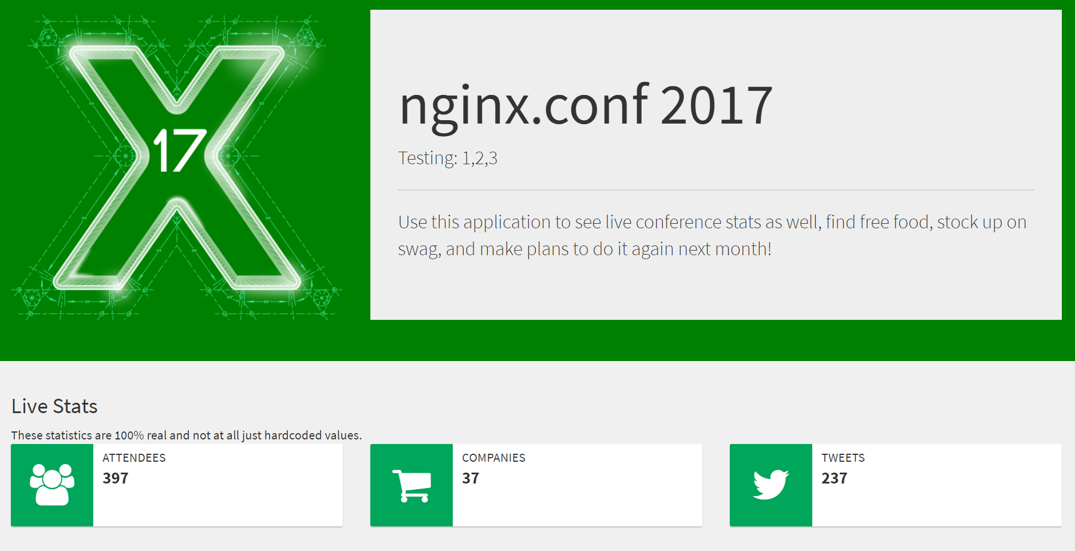
Blue-Green Version 1
Lessons
green-site
green-stats
live-demo
green-demo
next-demo
blue-site
blue-stats
blue-demo

Slide 11
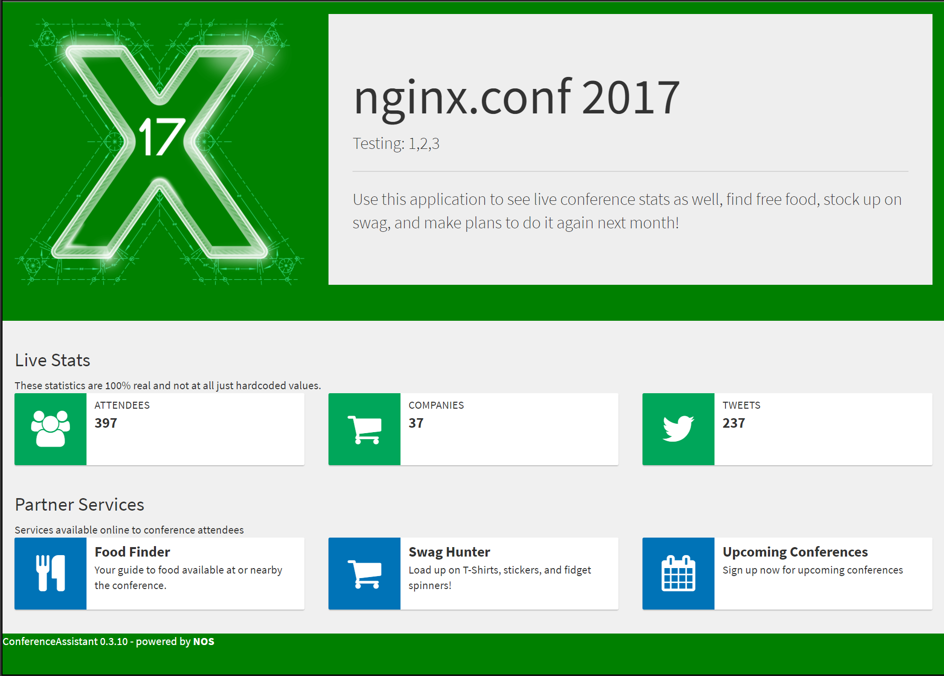
Blue-Green Version 2
Lessons
live-site
live-stats
live-demo
next-site
next-stats
next-demo
live-demo
live-food
live-swag
live-upcoming
next-demo
live-food
live-swag
live-upcoming
next-food
next-swag
next-upcoming

Slide 12
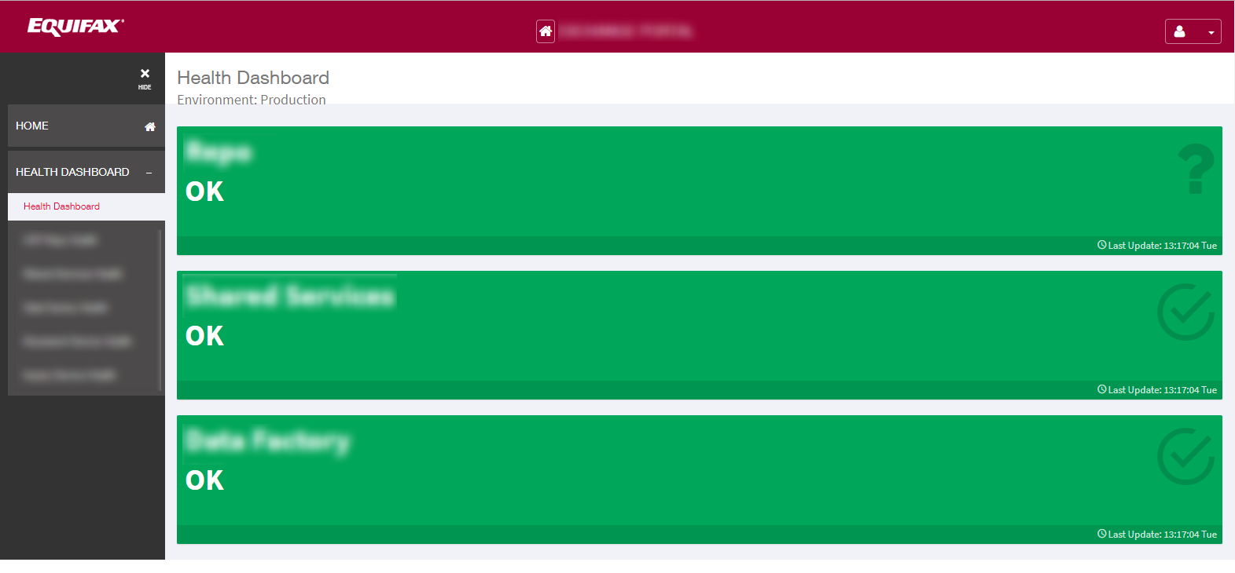
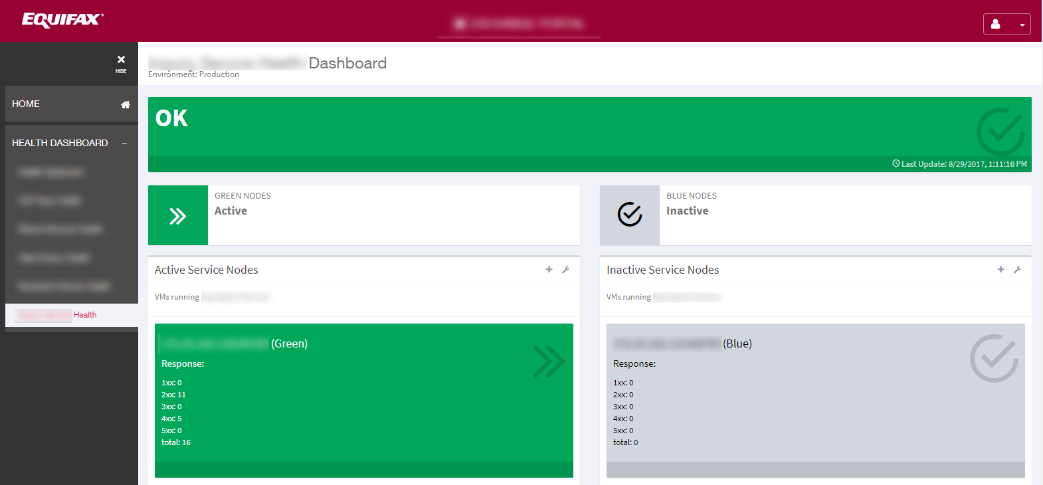
Lessons Learned: Visibility is Crucial
Dashboards query / status
and application nodes to
provide holistic health view
Notes:
We built custom dashboards for important applications that query health and display integrated viewers. The nginx+ /status endpoint made it easy to integrate nginx information into these dashboards.

Slide 13
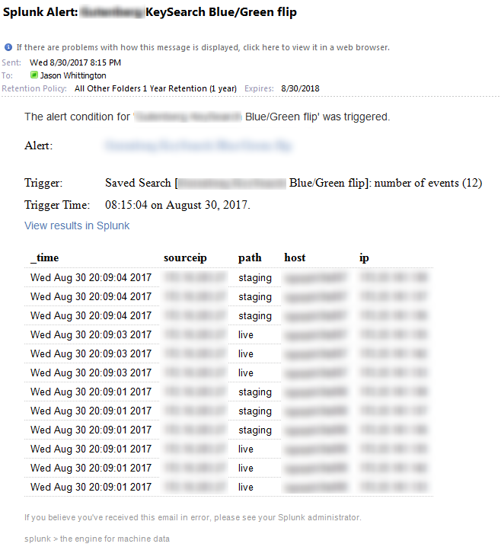
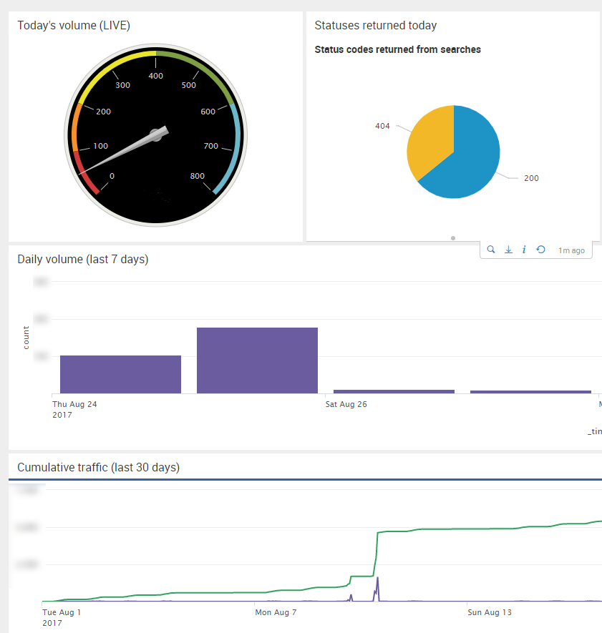
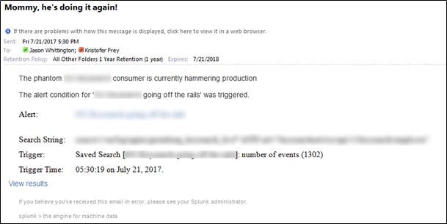
Visibility: Splunk

Slide 14
Lessons Learned: General Challenges
httponly/secure cookie management
State management
Dashboard isn't good enough
“State” files are a pain
Cluster coherency a challenge to manage
No single API endpoint for cluster
Access Control
Lack of LDAP integration
Proxying to external resources

Slide 15
Future Efforts
Higher-order integrations
“Single source of truth” for “currently active color
Consul? etcd?
Active/Active and data center failover
No easy way to replace F5 GTM

Slide 16
Questions?
?

Slide 17
Thank you!
Demos and other artifacts at
jawhitti.github.io/nginx
September 2017 | Version 1.0

